Slide 1


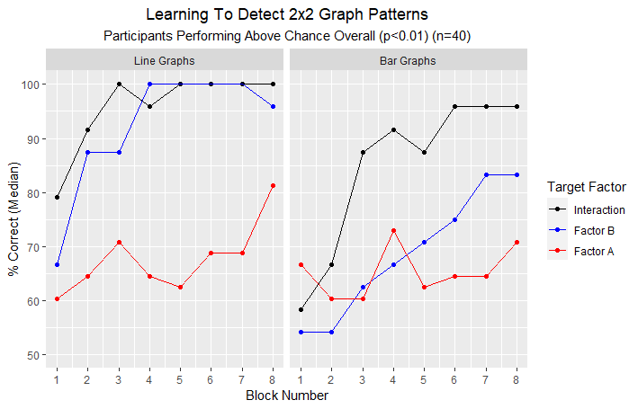
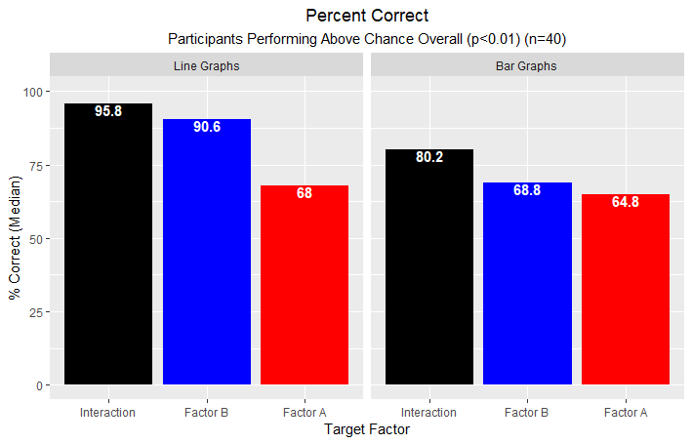
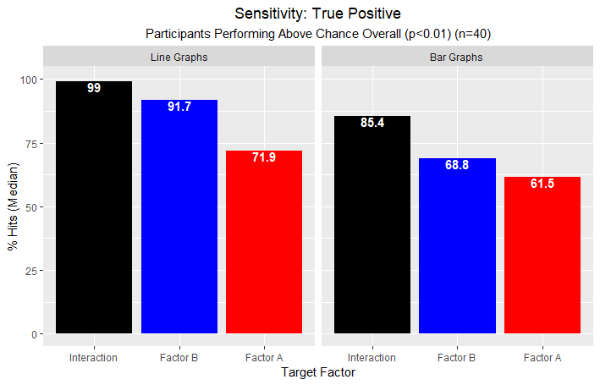
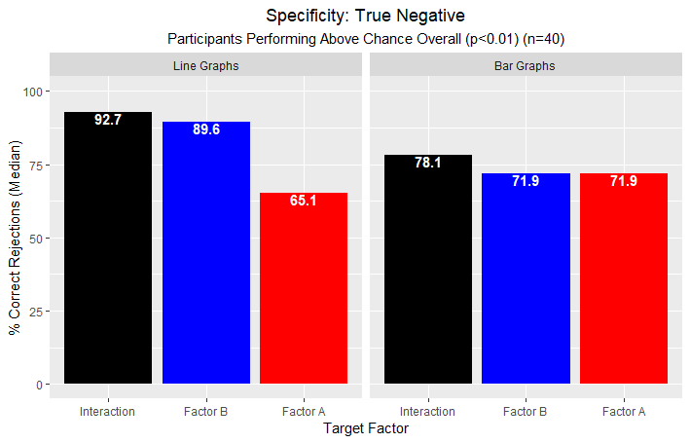
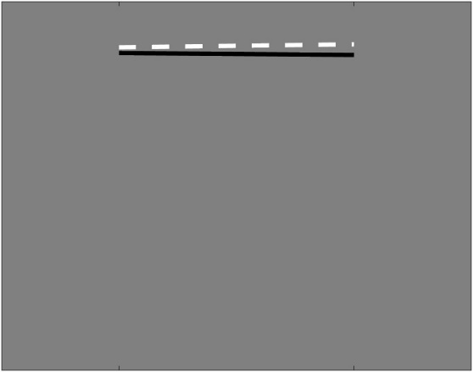

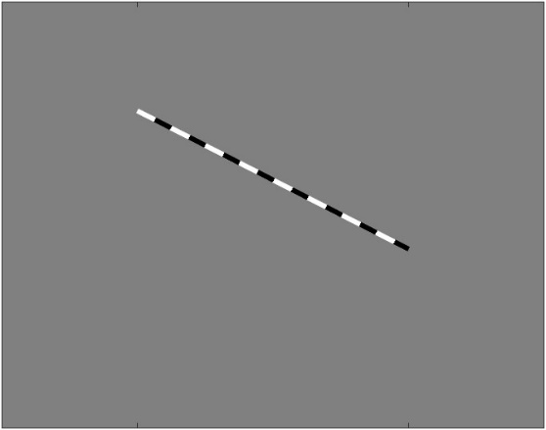
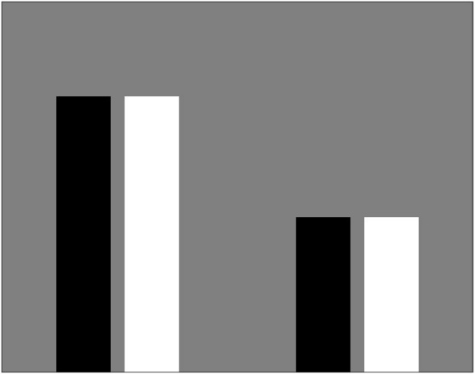
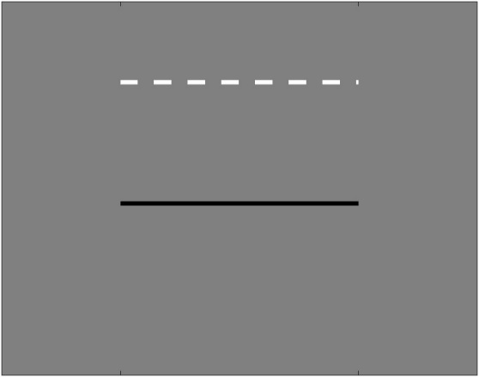
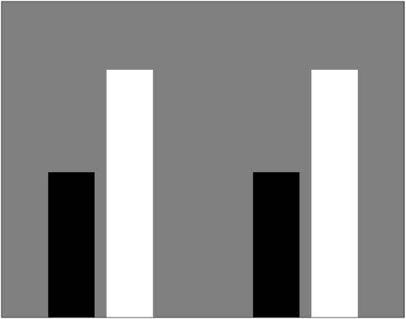
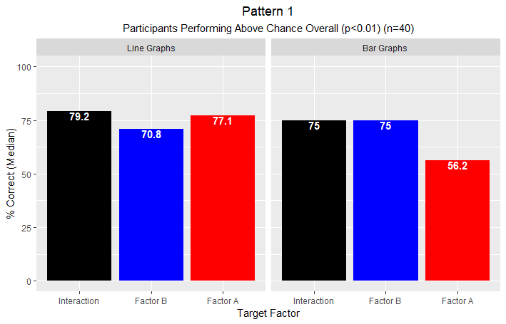
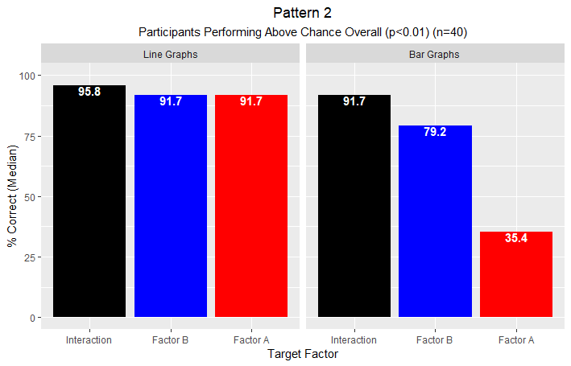
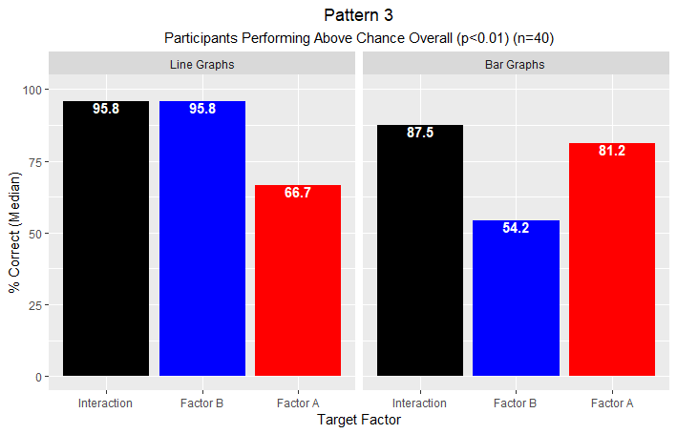
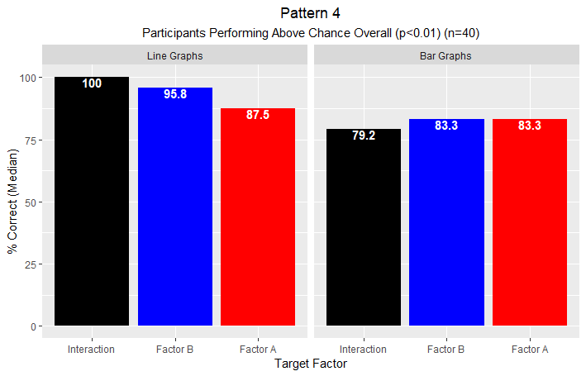
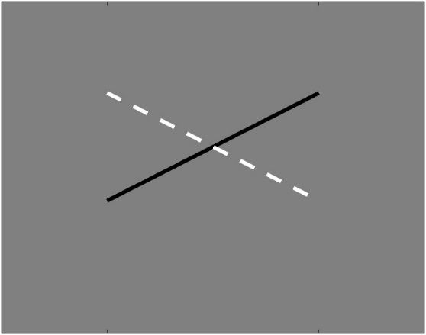
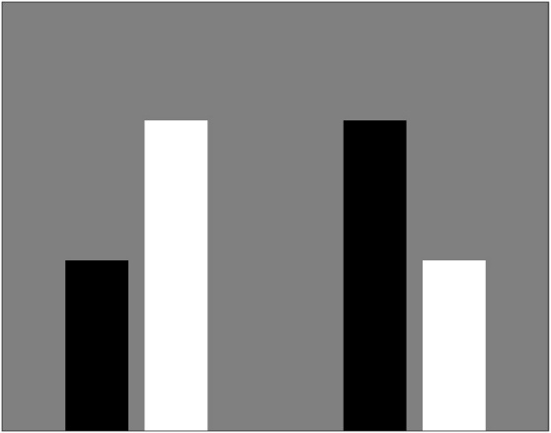
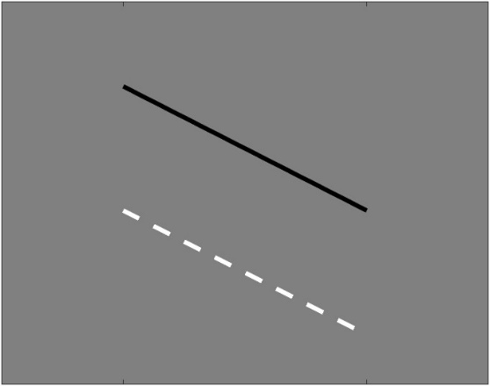
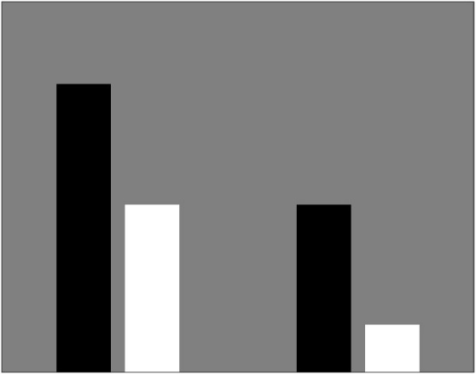
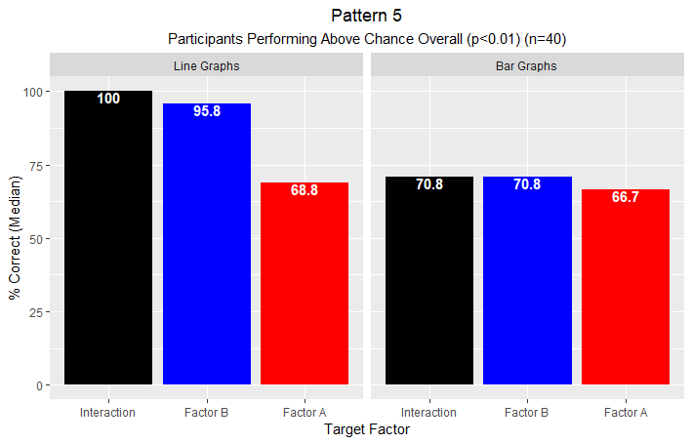
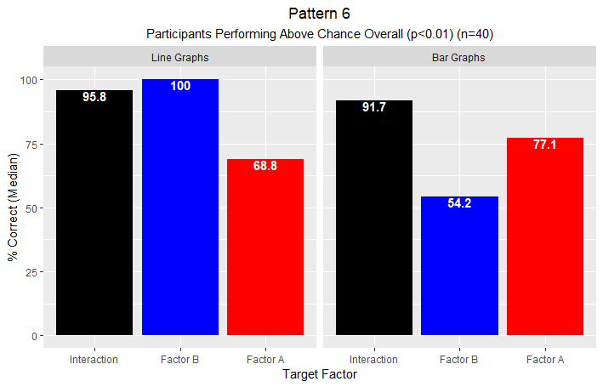
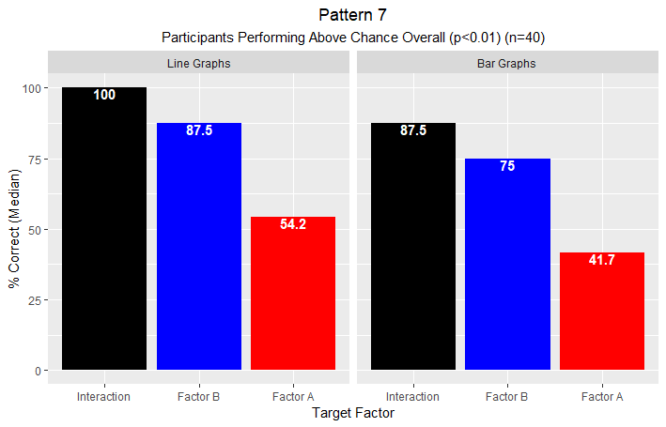
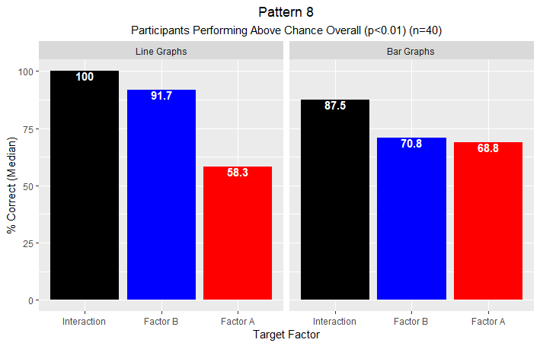
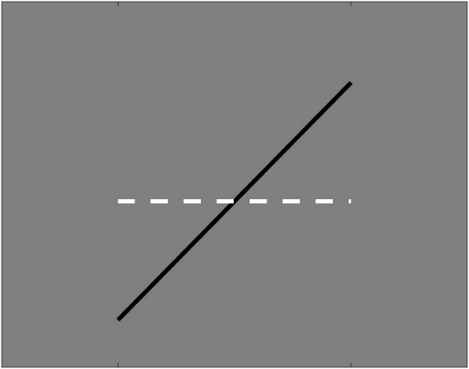
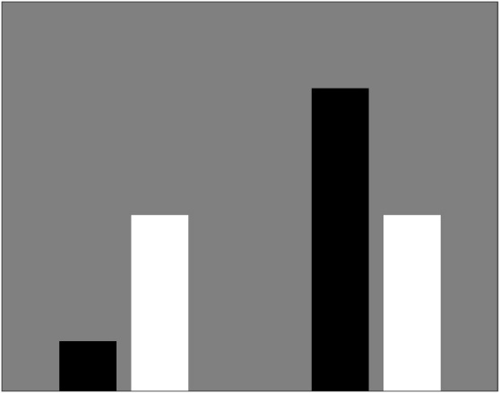
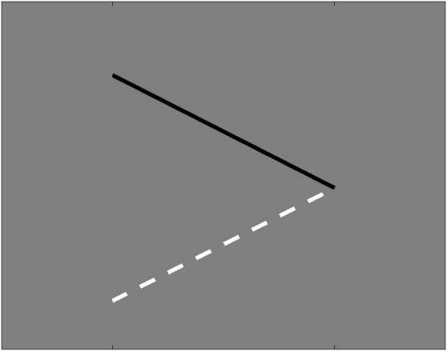
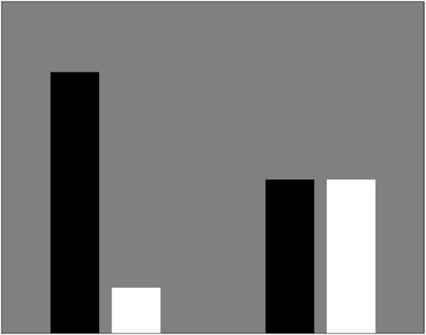
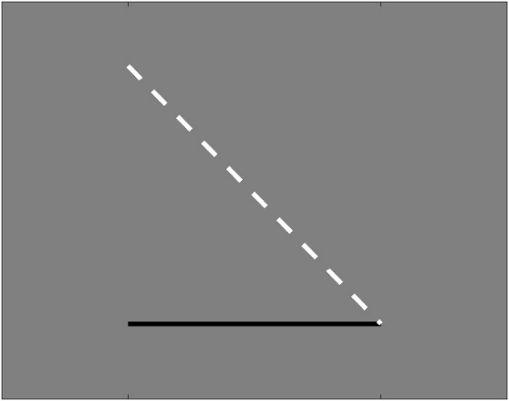
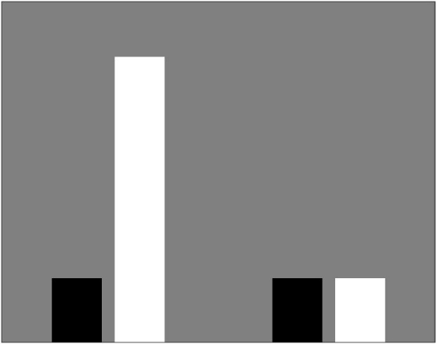
Learning to Detect Patterns in 2x2 Graphs
Nestor Matthews, Megan Broderick, Samantha Kozlowski
Department of Psychology, Denison University, Granville Ohio, USA
Wanna Practice?
Poster
Introduction
Results
Prior studies on 2x2 graph comprehension had participants either "think aloud"^{(1,2)} or
provide written descriptions⁽³⁾ about 2x2 main effects and interaction effects. Those methods privilege declarative knowledge (what can be stated). Here, we measured perceptual learning in 2x2 graph-pattern-detection using a trial-and-error task that does not require declarative knowledge.
Line-graph superiority effect for Factor B, and for Interaction effects (each p<0.001).
Interaction-learning significantly exceeded Factor-A learning (p=0.009).
Factor A generated 12 of the 18 subjects (p=0.003) who failed to perform above chance.
Overall, sensitivity significantly exceeded specificity (median 90.1% vs 85.9%) (p=0.014).
Pattern 8 performance > Pattern 1 performance (median 87.5% vs 75%) (p=0.033).
Methods
Participants: 58 students from an introductory psychology course completed the experiment.
Stimuli: The eight possible 2x2 graph patterns, shown as either line graphs or bar graphs.
Pattern # | Factor A L/R Diff | Factor B Color Diff | Interaction Slope Diff | Line Graph | Bar Graph
1 | n.s. | n.s. | n.s.
2 | SIG | n.s. | n.s.
3 | n.s. | SIG | n.s.
4 | n.s. | n.s. | SIG
5 | SIG | SIG | n.s.
6 | SIG | n.s. | SIG
7 | n.s. | SIG | SIG
8 | SIG | SIG | SIG
Pattern Analysis
Discussion
Our findings suggest significant biases in ensemble perception -the ability to extract summary
statistical information from groups of similar objects⁽⁴⁾. Notably, flipping a significant main effect
from Factor A to Factor B while also switching the data visualization from bar graphs to line
graphs improved the median percent correct from 64.8% to 90.6%. Regarding statistics education,
our pattern analysis suggests a need for students to practice identifying null effects in 2x2 graphs.
Task: Subjects classified 192 graphs into two initially unknown categories, Category “N” vs Category “Y”; these mapped to n.s. vs sig effects in one of 3 randomly assigned target factors.
References
Research Design: 3x2 → Target Factor (“A”, “B”, “Interaction”) by Graph Type (Line versus Bar).
(1) PMID: 23516801; (2) PMID: 26579052; (3) PMID: 25164403; (4) PMID: 28892638.

